Slide 1
AI Quality Control of NOAA Tide Gauge Observations
Gregory Dusek, Armin Pruessner, Elim Thompson¹, Lindsay Abrams
Erick DiFiore, George Story, Philippe Tissot²
Xu Chen³
NOAA NOS Center for Operational Oceanographic Products and Services
¹ Systems, Integration & Development, Inc. at NOAA NOS CO-OPS
²Texas A&M Corpus Christi, Conrad Blucher Institute
³Florida State, COAPS
2020 NOAA AI Workshop – September 3, 2020

Slide 2
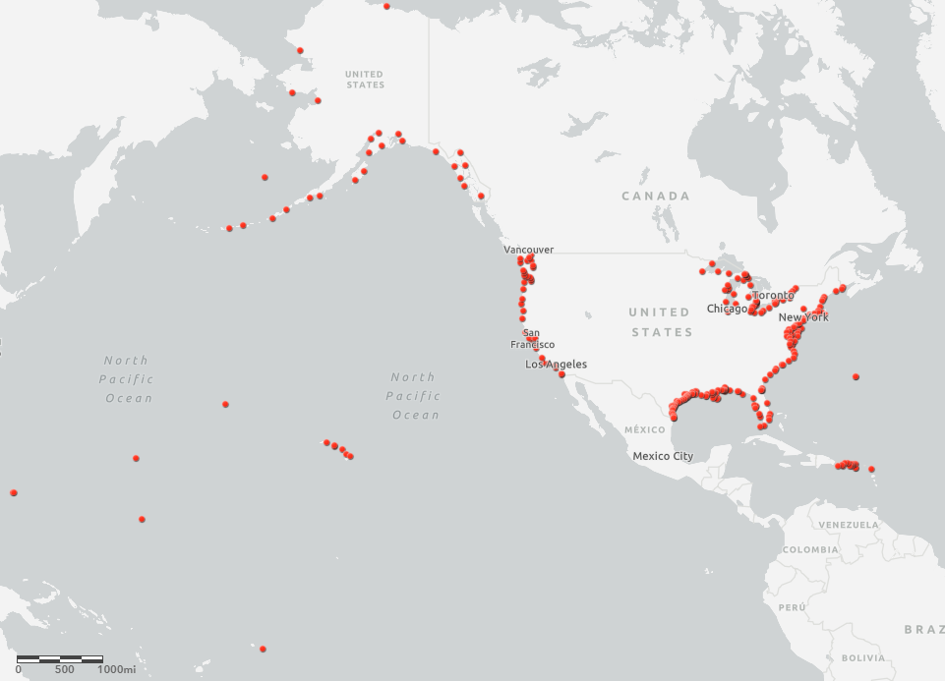
Active NOAA NOS Water Level Observations

Slide 3
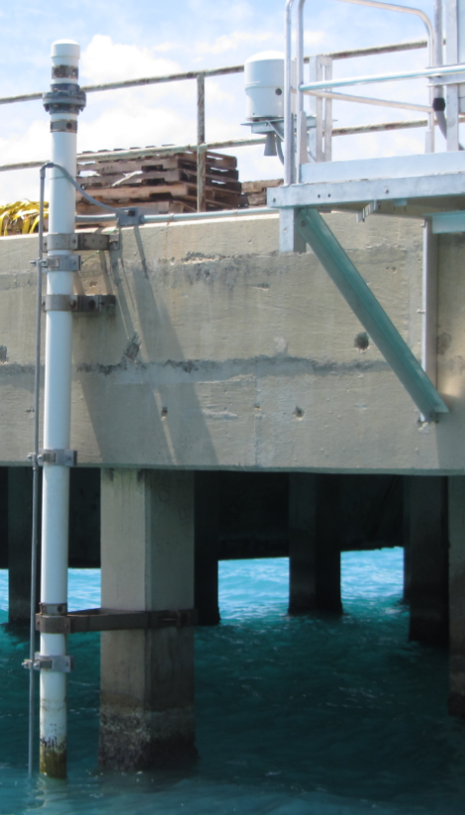

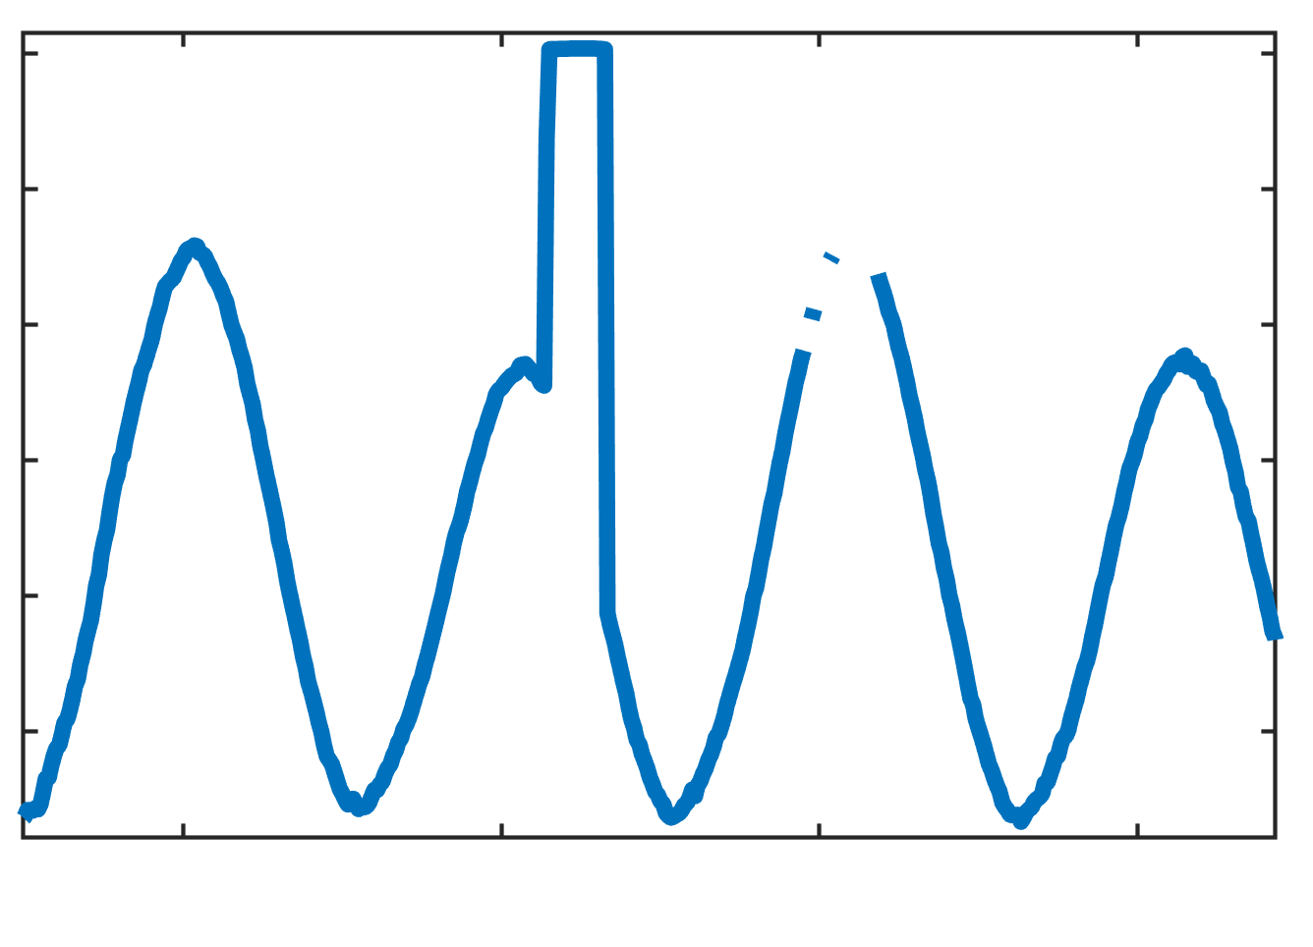
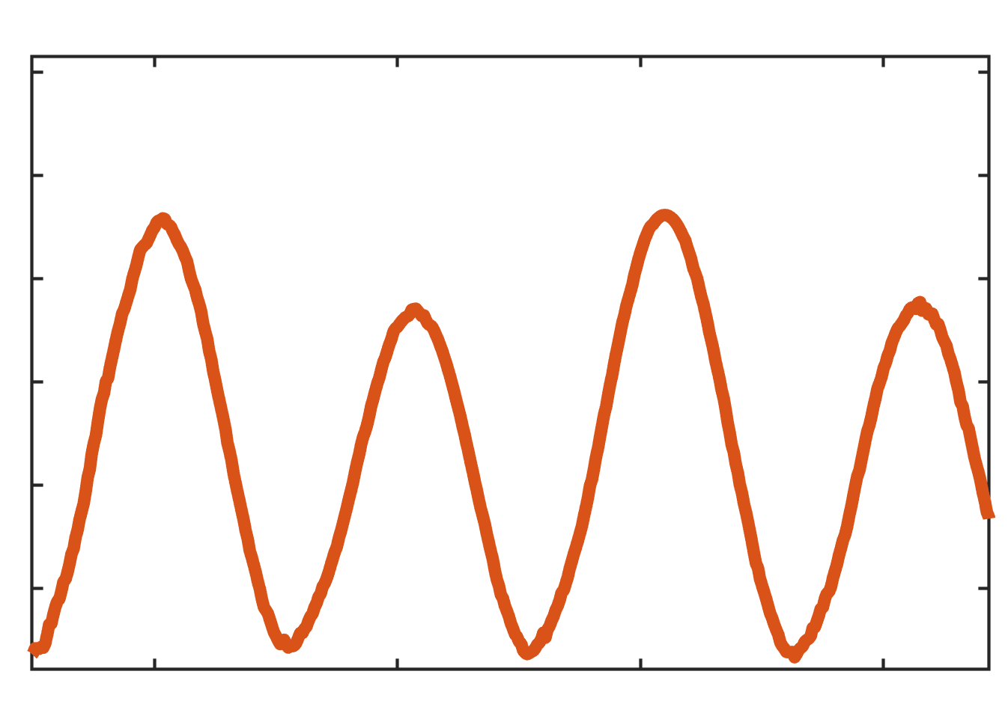
Water level data pipeline
Primary + Backup water levels
Manual processing and verification
Preliminary Data
Verified data
Onsite
QC
Notes:
Onsite QC – 1Hz outliers 3Std are removed – then 6 minute mean is recomputed

Slide 4
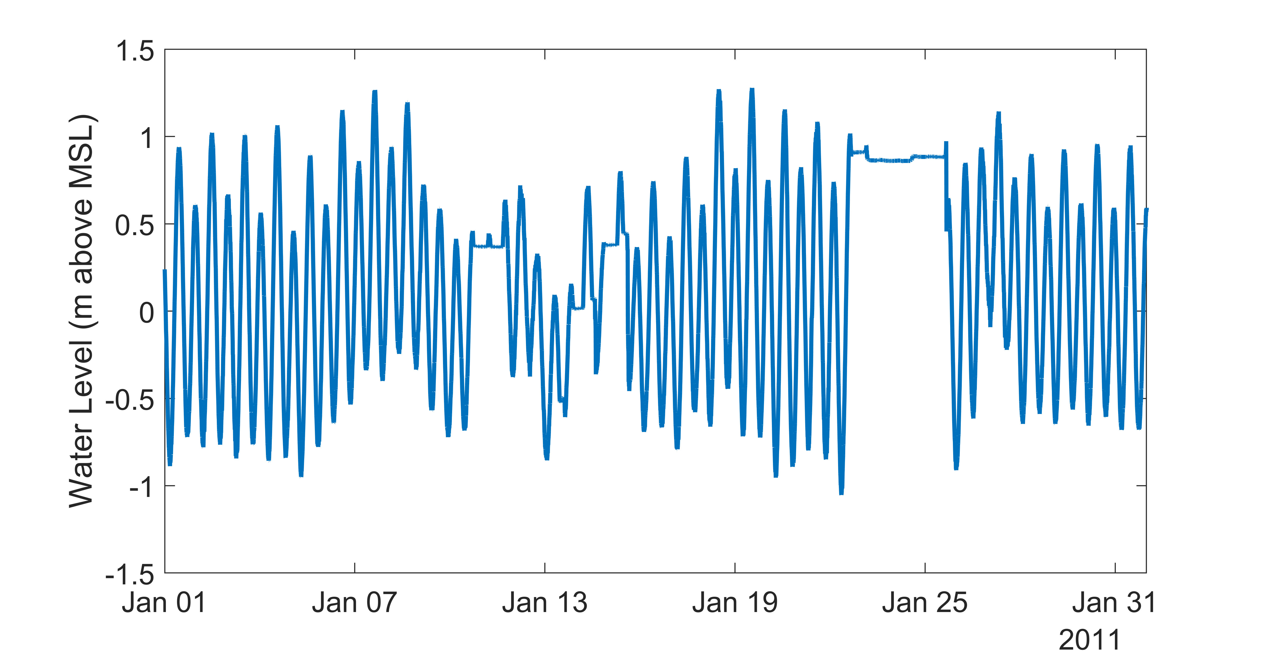
Manual water level data processing and verification
Notes:
Data plot from one month, one station
Then multiply by 30
Then multiply by 8

Slide 5
Manual water level data processing and verification
Notes:
Roughly 30-40 stations per month
>~200,000 data points per month

Slide 6
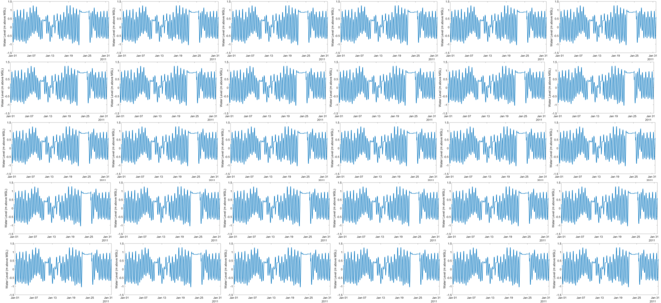
Manual water level data processing and verification
At least 2.1 million data points per month!
Notes:
Data plot from one month, one station
Then multiply by 30
Then multiply by 8

Slide 7
Can we use AI and Machine Learning to reduce manual intervention?
Classify a data point from the primary sensor as good or bad
Fill in any gaps with a combination of back-up obs, tide predictions and neighbor stations

Slide 8
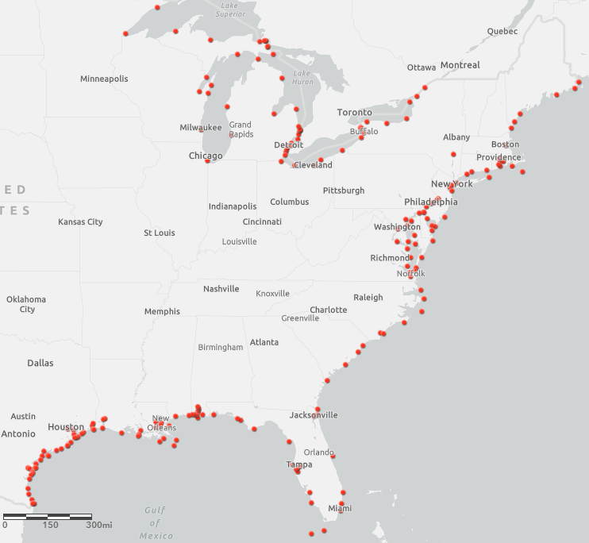
Methods
Five active water level stations
Data labeled “bad” if primary WL > 2cm from verified WL
Portland
Boston
Training
2007-2015
3.9 million points
2% labeled bad
Validation
2016-2017
820 thousand points
1.4% labeled bad
Atlantic City
Cape May
Lewes
Training
(balanced)
2007-2015
624 thousand points
10% labeled bad
Validation
2016-2017
820 thousand points
1.4% labeled bad

Slide 9
Methods
Cleaning and scaling procedure
Capping clear outliers
Filling missing values with 0
Adding a Boolean variable to indicate missing values
Scaled primary, backup and predictions by Great Diurnal Tide Range
Portland
Boston
Atlantic City
Cape May
Lewes

Slide 10
Classification Model
Simple Model – 7 features
Primary Water Level (6 min mean)
Backup Water Level + Boolean
Tide Predictions
Residual Water Level (Primary – Tide)
Sigma Water Level (6 min std) + Boolean
Target
Primary Water Level
Good (1) or Bad (0)
Complex Model – 16 features
Features above and…
Prev and Next 6 min Residual and Primary + Boolean
Prev 12 hours data count, residual mean and standard dev.

Slide 11
Classification Model
Logistic Regression
Max iterations = 10,000
Random Forrest
Estimators = 200
Max depth = 20
Min Samples per leaf = 2
Gradient Boosting
Estimators = 100 (200 for complex model)
Neural Network
2 hidden layers of 32 nodes (+ .2 dropout for complex model)
Sigmoid activation and Adam optimizer
Binary cross entropy loss function
20 epochs with early stopping
Skill assessment
Classification accuracy
Confusion matrix
Brier Skill Score
Area under ROC curve

Slide 12
Validation Results
Model | Accuracy | Bad Point Accuracy | BSS | AUC | Training time (8 CPUs)
Logistic Regression | 98.9 | 42.2 | 23.4 | 0.71 | 2.5 sec
Random Forrest | 99.7 | 83.2 | 79.9 | 0.92 | 1 min
Gradient Boost | 99.7 | 83.2 | 78.7 | 0.92 | 1 min
Neural Net | 99.7 | 83.2 | 77.6 | 0.94 | 5 min
Logistic Regression | 99.1 | 51.8 | 38.3 | 0.76 | 5.5 sec
Random Forrest | 99.7 | 83.1 | 80.5 | 0.92 | 2 min
Gradient Boost | 99.7 | 83.0 | 78.6 | 0.91 | 4 min
Neural Net | 99.7 | 83.0 | 80.7 | 0.95 | 11 min
Simple Model
Complex Model

Slide 13
What features are most important?
Simple Model – 7 features
Sigma – 0.50
Residual – 0.28
Primary – 0.14
All others < 0.04
Complex Model – 16 features
Residual Std over previous 12h – 0.32
Sigma – 0.23
Residual – 0.13
Previous 6 minute Residual – 0.09
Next 6 minute Residual – 0.09
All others < 0.06

Slide 14
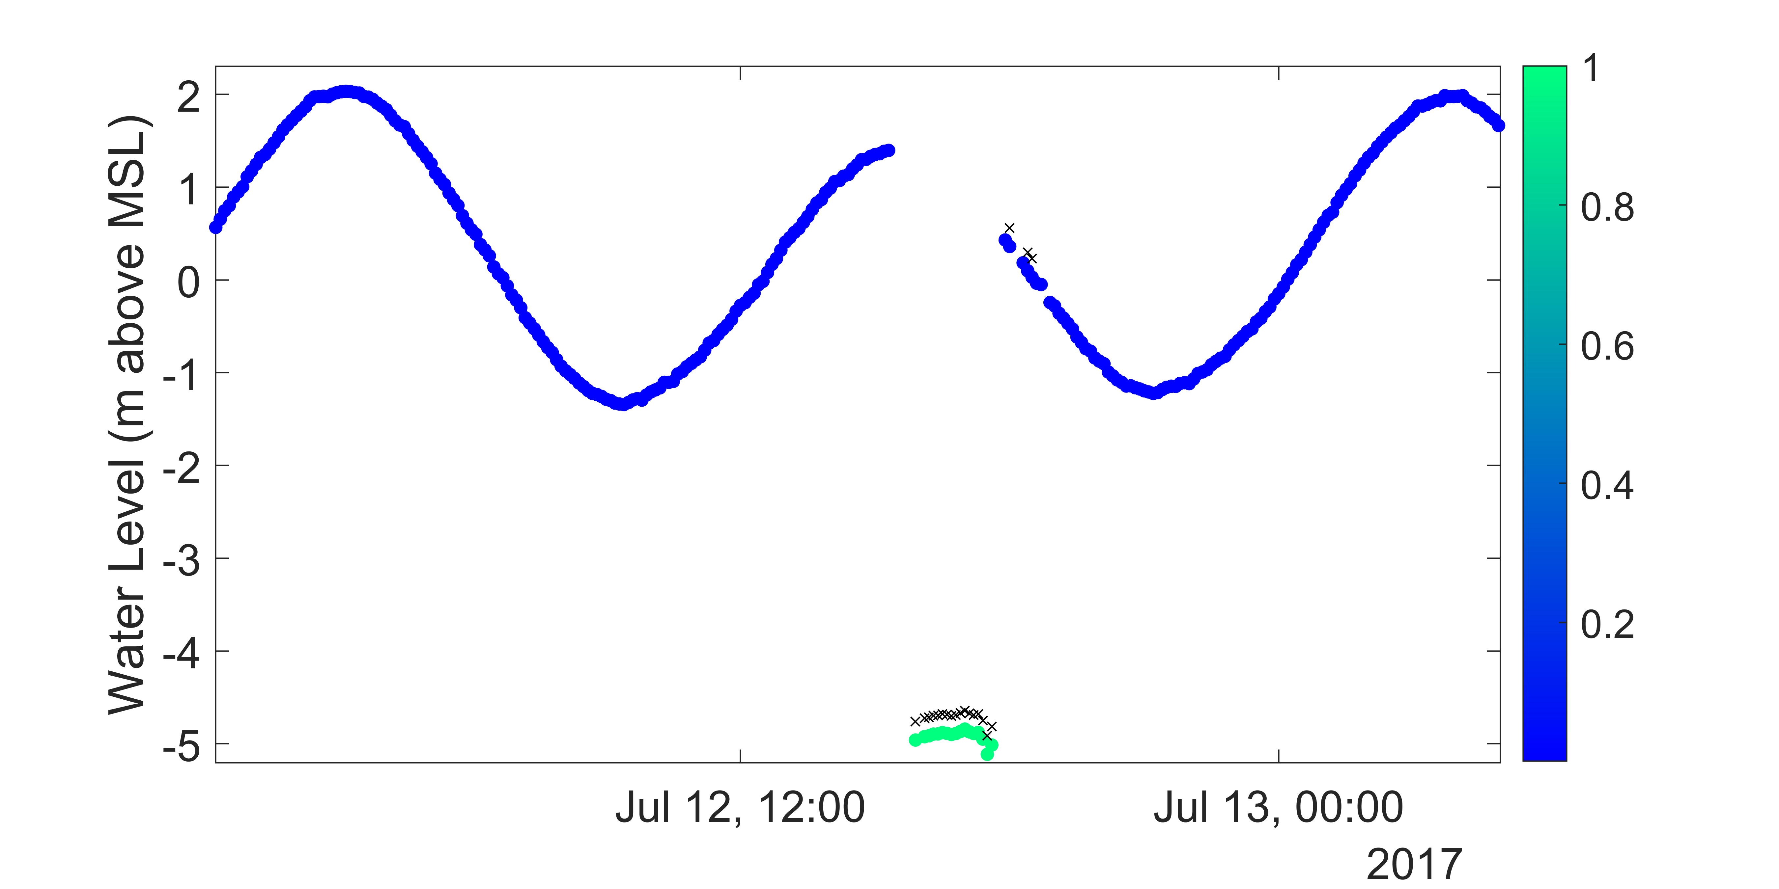
Model predicted classification at Cape May, NJ
Bad Point Likelihood

Slide 15
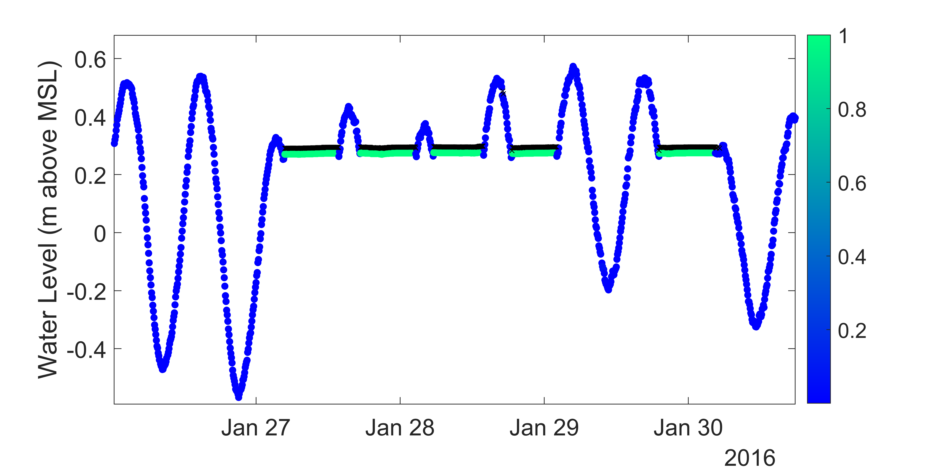
Model predicted classification at Atlantic City, NJ
Bad Point Likelihood

Slide 16
Gap Filling Example – Cape May, NJ
Training
2007-2014
All data points
700 thousand points
Validation
2015-2017
Only times with manual fills
5175 points
Regression Model – 24 features
Backup and backup residual water level + Boolean
Tide Predictions
Previous 18 and next 18 minutes of primary and residual + Boolean
Neighbor residual water level + Boolean
Target
Verified Water Level

Slide 17
Gap Filling Example – Cape May, NJ
Linear Regression
Random Forrest
Estimators = 200
Max depth = 20
Min Samples per leaf = 2
Validation Results
Model | MSE (cm²) | MAE (cm) | Training time (8 CPUs)
Linear Regression | 2.7 | 13.4 | 1 sec
Random Forrest | 0.36 | 3.0 | 6 minutes
Neural Network | 0.2 | 2.7 | 4 minutes
Neural Network
3 hidden layers of 128 nodes
Adam optimizer
MSE loss function
20 epochs with early stopping

Slide 18
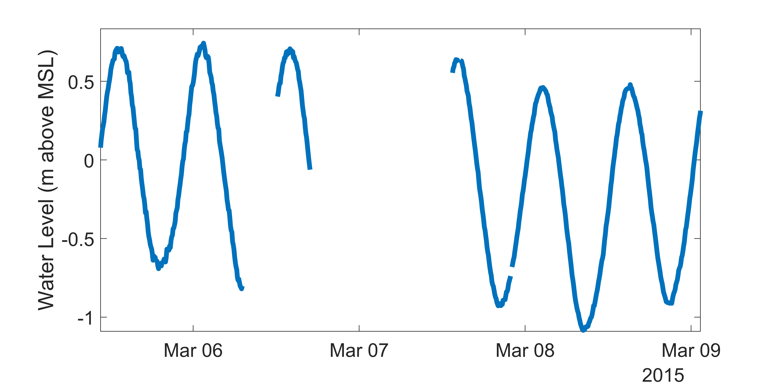
Model predicted filled data at Cape May, NJ

Slide 19
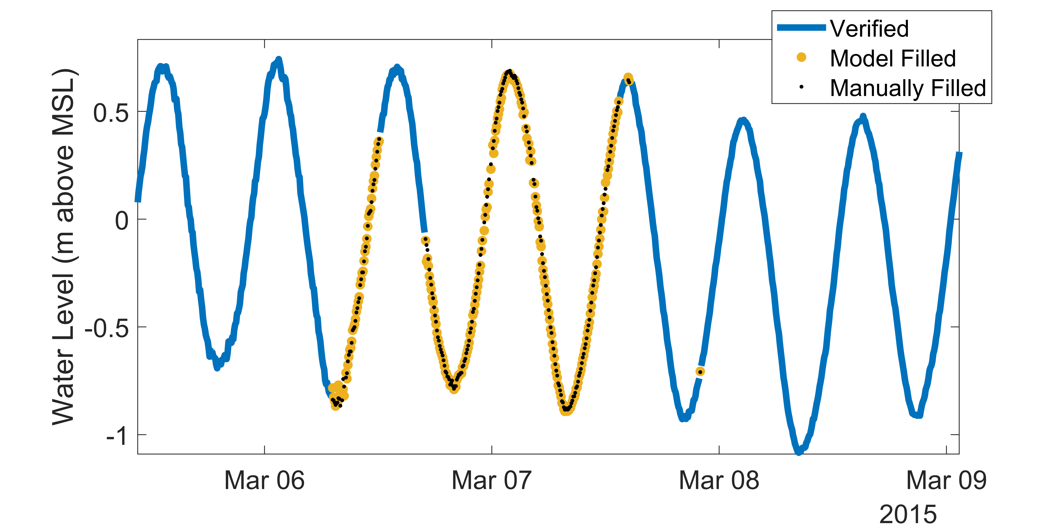
Model predicted filled data at Cape May

Slide 20
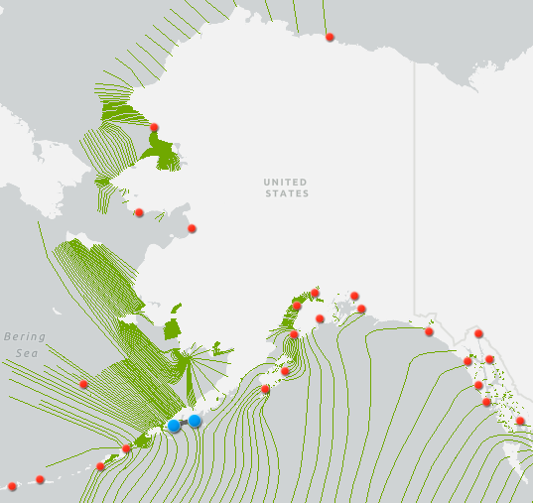
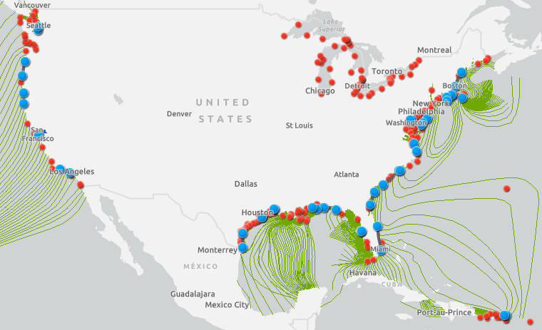
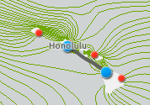
Next steps – training with 49 stations
Notes:
Training on 9.8 million data points – 200k per station (2007 – 2016) (down from ~43 million total)
Validation on 8.1 million data points – ~175k per station (2017-2018)
Testing on 2019,2020

Slide 21
Next steps – training with 49 stations
Initial validation results with Simple QC model
37/49 stations > 99% accurate
Data issues to investigate with remaining stations
Testing 11 point LSTM NN for both classification and gap filling

Slide 22
Conclusions
ML approaches can be used to accurately classify bad water level data
Classification model accuracy is robust across model variations and approach
ML gap filling at initial test location shows promise
CO-OPS is striving for operational implementation within several years
Substantially reduce resource requirements
Potentially enable verified data on a daily basis instead of monthly

